Slide 1

Project Quake or Not to Quake
Team Members: Alex Ayala, Alexandre Beauchamp, Anthony Ambs, Brett Baker, Ian Alderson, and Rayne Taylor

Slide 2
The Challenge
Planetary seismology missions face challenges with handling data
High power requirements for continuous transmission to Earth
Large amounts of noise are needlessly transmitted
We created a program to identify seismic activity
Will reduce the amount of data transmitted
Used data from Apollo missions and Mars InSight Lande

Slide 3
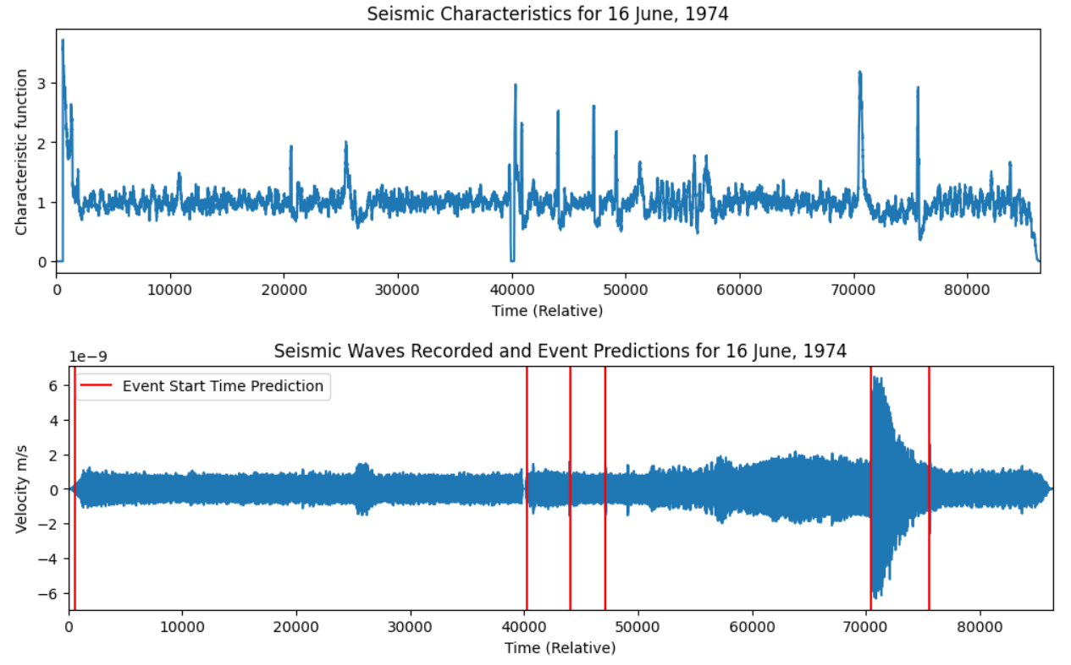
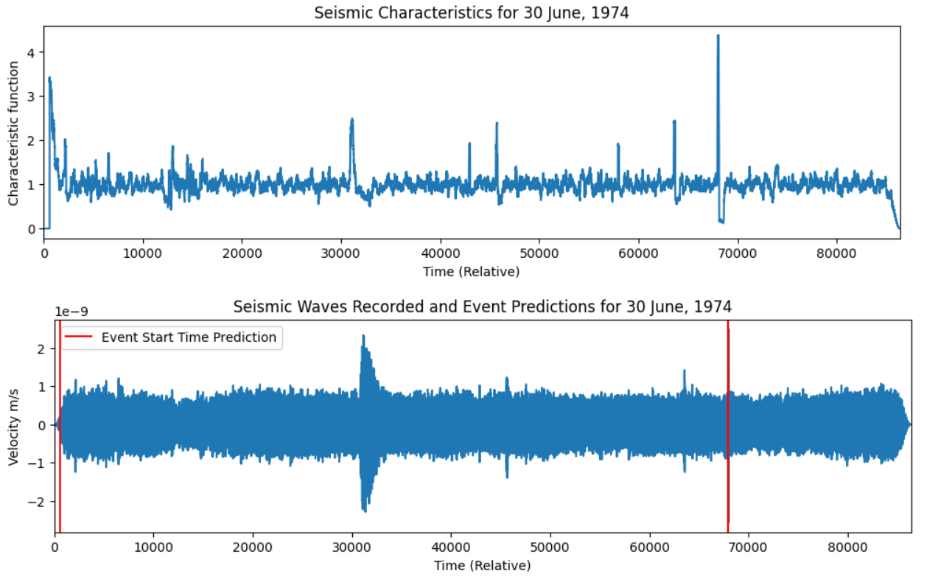
Short-term Average/Long-term Average (STA/LTA) Detection Algorithm
Figure 1
We began with an STA/LTA detection algorithm
Consistently identified the onset of seismic activity [1]
Was prone to many false positives [1]
Missing information would skew the algorithm [2]
Figure 2

Slide 4
Data Preparation for Machine Learning
Initial datasets not well suited for machine learning
Not yet normalized
Very few positive examples
Steps
Sliding window approach
Supplement with Earth seismic data
Supplement with synthetic data
Normalization

Slide 5
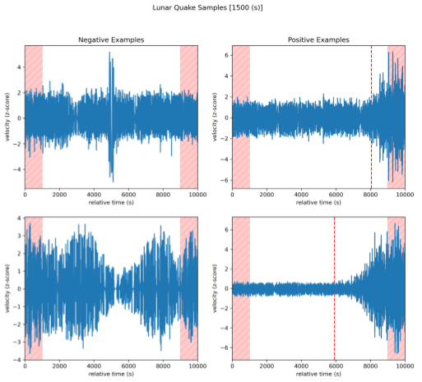
Sliding Window
Create a window of configurable size
Slide the window by a configurable size
Mark the edges as “dead zones” to avoid penalizing models
For the provided Apollo 12 training set, increase positive examples from 76 -> 1,200

Slide 6
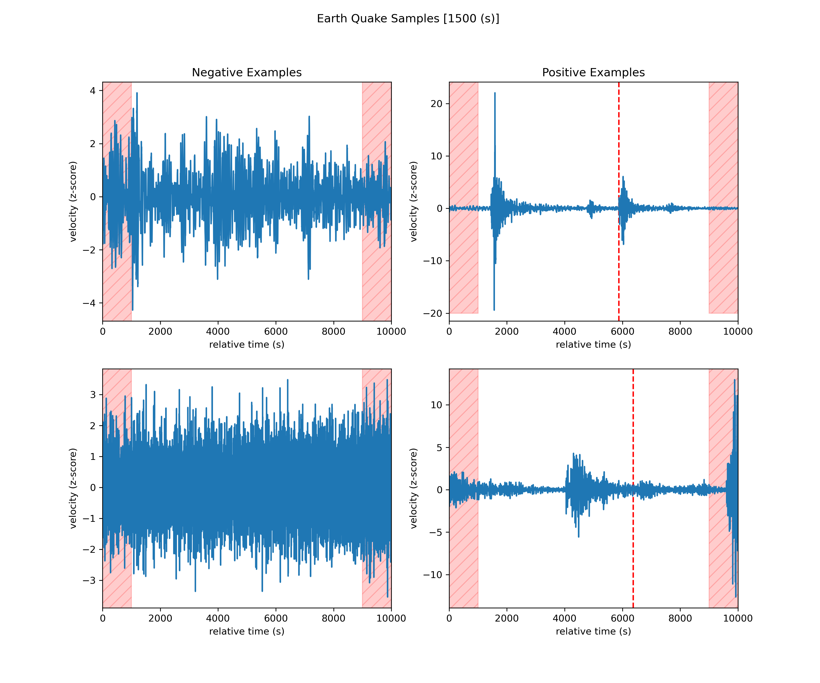
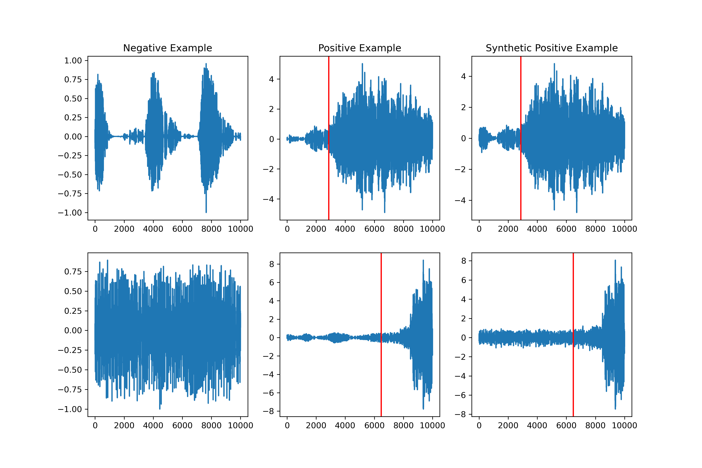
Supplemented training data with Earth Seismic samples
Synthetic positive examples are produced by overlaying a true positive and true negative example

Slide 7

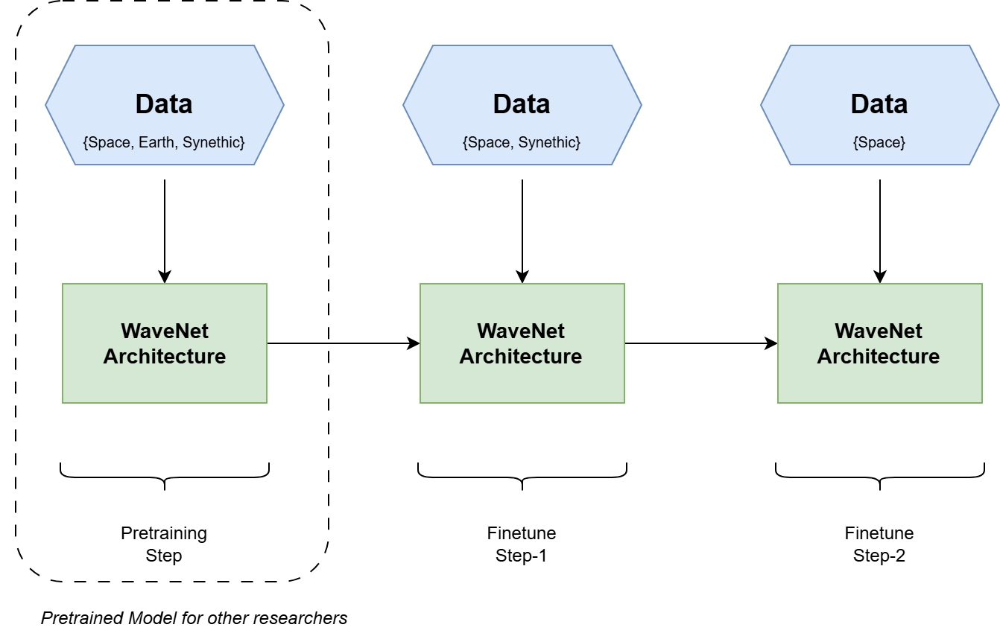
Training Pipeline
We completed the pretraining step
Offers a pre-trained model for other researchers
Further steps will be to finetune WaveNet Architecture

